Slide 1
SOEN 384
Management, Measurement and Quality Control http://users.encs.concordia.ca/~s384_2/
Instructor: Dr. Olga Ormandjieva
Lecture 17:
Management Key Area 3: Project Monitoring & Control
Lecture 17 reading material

Slide 2
Agenda
Long review
Schedule development
Project Enactment: Monitoring and Control
Next?
SOEN384-L17: monitoring&control

Slide 3

The purpose of planning
Goal - to arrive iteratively to an optimal answer to the overall product development question of what to build:
  Features, Resources, Schedule
Planning process = quest for value
  reduce risk, reduce uncertainly, support reliable decision making, convey information, establish trust
SOEN384-L17: monitoring&control
Notes:
Reliable estimates enable reliable delivery
A plan communicates and establishes a set of baseline expectations

Slide 4
Schedule the Project or Iteration/Phase
Scheduling: a process showing relationship of activities and determining of the project time and the timing of the activities comprising the project
In scheduling we consider the following questions:
  What are the activities of the project? (WBS)
  how long the project is expected to take?
  when each activity may be scheduled (started and ended)?
  How resources can be used more proper?
  What are the critical bottlenecks in the project?

Slide 5
Sample WBS high-level structures
Features
Feature 1
Feature 2
Feature 3
...
User stories
User story 1
User story 2
User story 3
...
Tasks
Task 1
Task 2
Task 3
...
SOEN384-L17: monitoring&control

Slide 6
Sample planning based on WBS high-level structure
Features | Actual Effort | Estimated effort | Priority (based on business value, risk assessment, ...) | Iteration#
Feature 1
Feature 2
Feature 3
...
SOEN384-L17: monitoring&control

Slide 7
Sample detailed WBS
Average task% from previous projects
Features | tasks | Actual Effort | Estimated effort
Feature 1 | Feature 1 tasks |  | Effort_F1
 | Management |  | Effort_F1*10%
 | Requirements |  | Effort_F1*15%
 | Design |  | Effort_F1*15%
 | Implementation |  | Effort_F1*40%
 | Quality Control |  | Effort_F1*20%
Feature 2 | Feature 2 tasks |  | Effort_F2
...
Use the Estimated Effort to calculate task duration:
Time = effort / resources
SOEN384-L17: monitoring&control

Slide 8
Schedule Development
Analyze task sequences, task durations, and resource requirements to create the project schedule.
  Output: expected schedule of tasks with projected start times, durations, and end times is produced
SOEN384-L17: monitoring&control
Notes:
includes the processes required to ensure timely completion

Slide 9
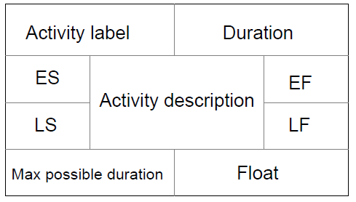
Activity-on-node networks
An activity-on-node network is a directed mathematical graph nodes represent activities.
A node includes certain information about an activity, such as earliest and latest times. Edges represent transitions from one activity to another
Example in class
SOEN384-L17: monitoring&control

Slide 10
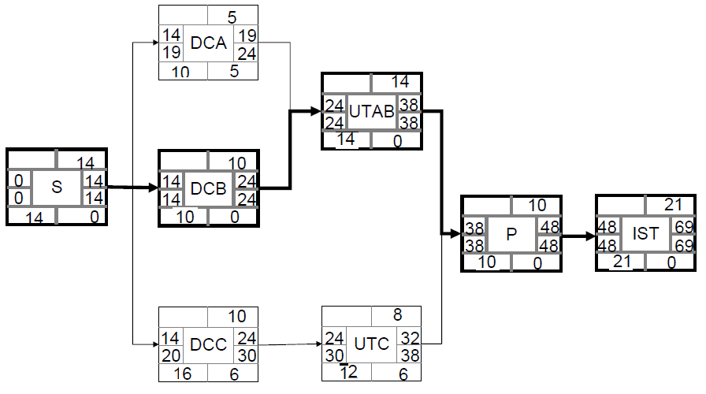
Example from last lecture
SOEN384-L17: monitoring&control

Slide 11
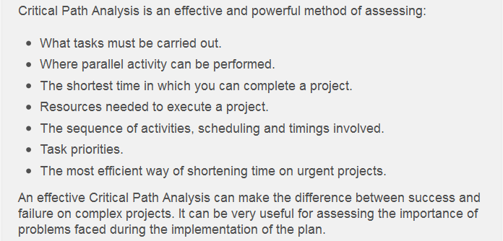
Critical Paths Key Points http://www.mindtools.com/critpath.html
SOEN384-L17: monitoring&control
Notes:
As with Gantt Charts, Critical Path Analysis method helps you to plan all tasks that must be completed as part of a project. They act as the basis both for preparation of a schedule, and of resource planning. During management of a project, they allow you to monitor achievement of project goals.
A further benefit of Critical Path Analysis is that it helps you to identify the minimum length of time needed to complete a project. Where you need to run an accelerated project, it helps you to identify which project steps you should accelerate to complete the project within the available time.

Slide 12
Questions http://www.mindtools.com/critpath.html
What if you need to complete a project earlier than your critical path analysis says is possible?
    Assign more resources to increase productivity [may raise the project cost]
      doubling resources at any stage may only improve productivity by, say, 50% as additional time may need to be spent getting the team members up to speed on what is required, coordinating tasks split between them, integrating their contributions etc.
      shortening the original critical path of a project can lead to a different series of activities becoming the critical path (Example: in the tutorial next week)
SOEN384-L17: monitoring&control

Slide 13
Agenda
Long review
Schedule development with Gantt Charts
Project Enactment: Monitoring and Control
Next?
SOEN384-L17: monitoring&control

Slide 14
Another scheduling tool:
Gantt Charts https://www.mindtools.com/pages/article/newPPM_03.htm
Gantt Charts:
  In around 1910, Henry Gantt, a management consultant and engineer, designed Charts to help manufacturing supervisors see whether their work was on, ahead of, or behind schedule
  Used to plan all tasks that must be completed as part of a project.
Step 1. List all essential activities in the plan (use WBS to establish what the activities are). For each task, note its earliest start date and its estimated duration (PERT)
Step 2. Set up a rough draft of your Gantt Chart
Step 3. prepare a final version of the Gantt Chart.
  Allocate Resources
,
Notes:
Planning tools also include automated scheduling tools that analyze the tasks
within a work breakdown structure, their estimated
durations, their precedence relationships,
and the resources assigned to each task to produce
a schedule in the form of a Gantt chart.
Task dependencies can be established and potential opportunities for completing tasks
concurrently and sequentially can be identified
and documented using a Gantt chart.

Slide 15
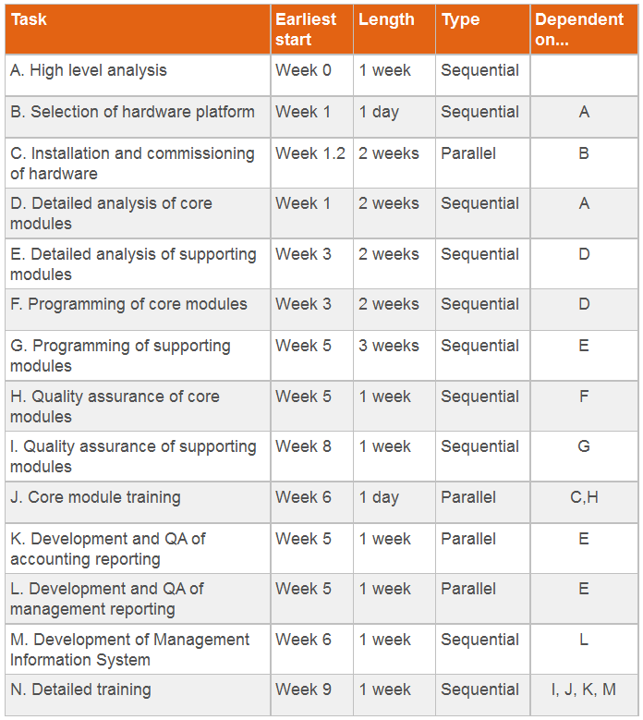
Gantt Chart Example - Planning a custom-written computer project
Step 1. List all activities in the plan
Example
Your organization will create a new "Software as a Service" product, and you're in charge of the project.
You decide to use a Gantt chart to organize all of the necessary tasks, and to calculate the likely overall timescale for delivery.
You start by listing all of the activities that have to take place, and you estimate how long each task should take to complete.
Your list looks as follows:
SOEN384-L17: monitoring&control

Slide 16
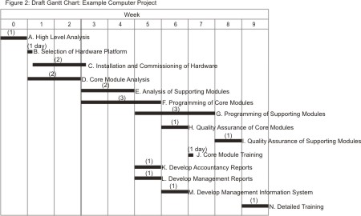
Gantt Chart Example - Planning a custom-written computer project
Step 2. Set up a rough draft of your Gantt Chart
SOEN384-L17: monitoring&control

Slide 17
Schedule and Resource Allocation
determining what resources [equipment, facilities, and people] and what quantities of each are associated with the scheduled tasks, including the allocation of responsibilities for completion (using, for example, a Gantt chart).
SOEN384-L17: monitoring&control
Notes:
This activity is informed and constrained by the availability of resources and their optimal use under these circumstances, as well as by issues relating to personnel (for example, productivity of individuals/teams, team dynamics, organizational and team structures).

Slide 18
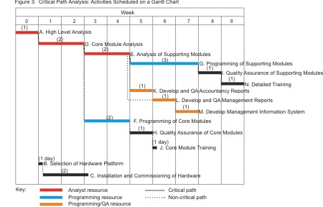
Gantt Chart Example - Planning a custom-written computer project http://www.mindtools.com/critpath.html
Step 3. prepare a final version of the Gantt Chart.
Resources:
  1 analyst for the first 5 weeks.
  1 programmer for 5 weeks starting week 4.
  1 programmer/QA expert for 3 weeks starting week 6.
do not over-commit resource!
SOEN384-L17: monitoring&control
Notes:
By drawing this example Gantt Chart, you can see that:
If all goes well, the project can be completed in 10 weeks.
Note: Activities L and M have been moved back a week. This does not affect the critical path, but it does mean that a single programming/QA resource can carry out all three of activities K, L and M.
Analysis, development and testing of supporting modules are essential activities that must be completed on time.
Hardware installation and commissioning is not time-critical as long as it is completed before the Core Module Training starts.

Slide 19
Discussing the results
By drawing this example Gantt Chart, you can see that:
If all goes well, the project can be completed in 10 weeks.
If you want to complete the task as rapidly as possible, you need:
  1 analyst for the first 5 weeks.
  1 programmer for 5 weeks starting week 4
  1 programmer/QA expert for 3 weeks starting week 6
Analysis, development and testing of supporting modules are essential activities that must be completed on time.
Hardware installation and commissioning is not time critical as long as it is completed before the Core Module Training starts.
SOEN384-L17: monitoring&control
Notes:
Note: Activities L and M have been moved back a week. This does not affect the critical
path, but it does mean that a single programming/QA resource can carry
out all three of activities K, L and M.

Slide 20
Review of the Key Objectives of project planning
Feasibility assessment: Is the project possible within the required resource constraints?
  Example: if the project requires 12 months with 5 people, can it be done in 6 months with twice as many people?
Scheduling techniques: CPM, Gantt Chart
Allocation of resources
  What are the most effective ways of allocating
  resources to the project? When should resources be available?
Detailed Cost estimates

Slide 21
Project plan: Key Points
A project plan is a model of the process that the project team intends to follow to realize the project objectives.
  It brings together project scope, schedule, budget, estimation, and associated risks.
  It defines the process by which the objectives will be achieved, and the responsibilities in carrying out this process.
  Serves as a contract between the project team members and other stakeholders.
    Forms the basis for project monitoring and control.
SOEN384-L17: monitoring&control

Slide 22
Agenda
Long review
Schedule development
Project Enactment: Monitoring and Control
Next?
SOEN384-L17: monitoring&control

Slide 23
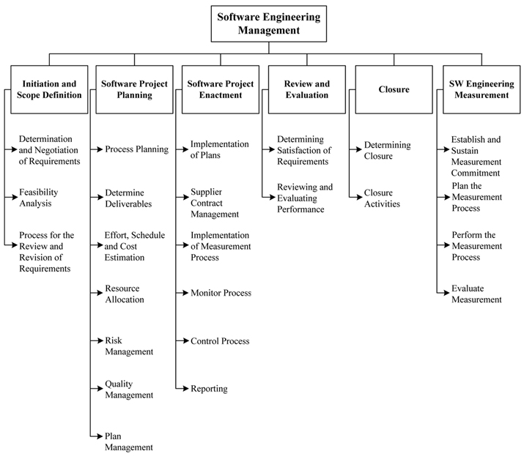
BREAKDOWN OF TOPICS FOR SOFTWARE ENGINEERING MANAGEMENT: SWEBOK
SOEN384-L17: monitoring&control

Slide 24
Revisiting process planning
What for ?
Features | Actual Effort | Estimated effort | Priority (based on business value, risk assessment, ...) | Iteration#
Feature 1
Feature 2
Feature 3
...
SOEN384-L17: monitoring&control

Slide 25
SEM – KA 3: Software Project Monitoring & Control
Project Monitoring & Control: use any observed differences between planned and actual values of project indicators to evaluate the status of the project and to support decisions to take corrective actions.
  Software Project Plan lists project iterations / milestones
  For each iteration, schedule, effort & quality are estimated before the iteration starts.
  For each iteration, schedule, effort & quality actuals are collected at the end of the iteration.
  If the actual deviates from the estimated by more than the limit specified in the plan at that iteration, then this fact is brought to the knowledge of project manager/ leader & a corrective action is initiated.
Notes:
Once a manager has the ability to track actual project measures against planning estimates, he or she can begin to use any observed differences to evaluate the status of the project and to support decisions to take corrective actions.

Slide 26
Activity Tracking indicators
  Planned Value (PV): for a given task, PV is defined as the effort planned for that task translated into cost.
  Earned Value (EV): % of PV of the work actually completed by a given point in time on the project schedule.
  Actual Cost (AC) (previously called Actual Cost of Work Performed - ACWP):
  The total of costs on tasks that have actually been completed by a given point in time on the project schedule.
SOEN384-L17: monitoring&control

Slide 27
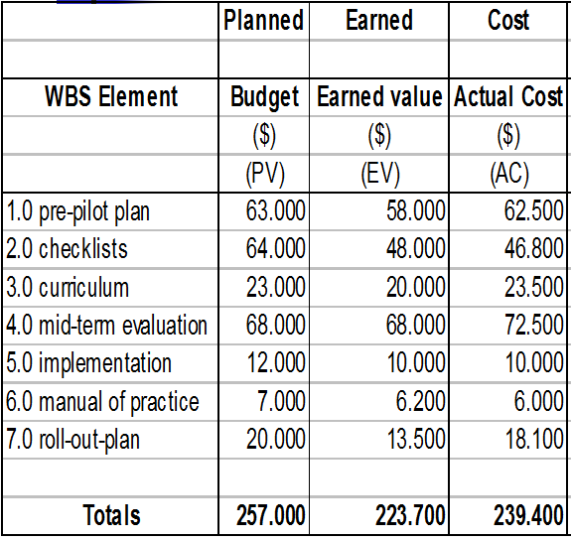
Example of Activity Tracking
[source: PMBOK, 2000]
SOEN384-L17: monitoring&control

Slide 28
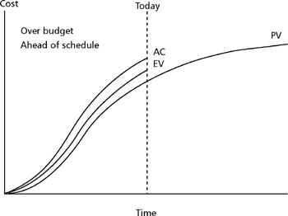
Examples
Interpreting indicators PV, EV, AC
The EV is higher than the PV; The project is ahead of schedule.
  More activities have been completed than were planned to be completed at this time.
SOEN384-L17: monitoring&control

Slide 29
The AC is higher than the PV and the EV => the project is over budget.
  We are spending more money to accomplish the work than we had planned, and we are spending more money to accomplish work than the EV for that work.
SOEN384-L17: monitoring&control

Slide 30
This could mean that the manager of this part of the project is working people overtime in anticipation of a problem that may be encountered in the near future.
There could be many explanations for these irregularities.
The report tells us that we should investigate to find out the cause for this.
SOEN384-L17: monitoring&control

Slide 31
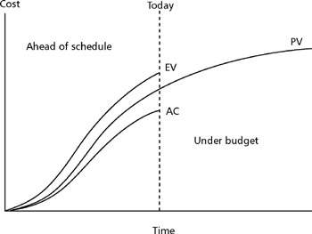
EV is above the PV.
  The project is ahead of schedule. More activities are being completed, and their earned value is being credited faster than planned.
  The AC is lower than the EV.
  The project is under budget
SOEN384-L17: monitoring&control

Slide 32
The AC is lower than the EV.
  We are spending less money than the earned value of the work that is being completed.
SOEN384-L17: monitoring&control

Slide 33
While this looks like a good situation—ahead of schedule and under budget—it is still not following the project plan.
It is possible that things are just going well.
It is also possible that some of the work is not being done as planned and that the quality of the work performed is suffering.
SOEN384-L17: monitoring&control

Slide 34
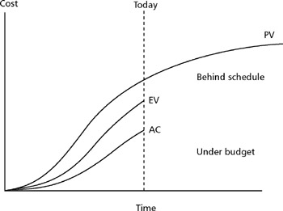
EV is less than the PV.
  The project is behind schedule.
SOEN384-L17: monitoring&control

Slide 35
The AC is less than the EV.
  Work is being accomplished with less cost than planned.
  A possible explanation for this situation is that the project is understaffed, but the people working on the tasks that are being done are doing a better than-average job.
SOEN384-L17: monitoring&control

Slide 36
Performance indicators
The values for PV, AC and EV are used in combination to provide measures of whether or not work is being accomplished as planned.
  Cost Variance (CV)
  Schedule Variance (SV)
  Cost Performance Index (CPI)
  Schedule Performance Index (SPI)
SOEN384-L17: monitoring&control

Slide 37
Cost Variance (CV)
Cost Variance (CV): EV – AC
  The difference between the earned value and the actual cost of work performed,
  Or
  (what you should have paid for work actually performed) –
  (what was actually paid for work actually performed)
SOEN384-L17: monitoring&control
Notes:
This is an absolute indication of cost savings (against planned cost) or shortfall at a particular stage of a project.
A positive variance means less money was spent for the work accomplished than was planned to be spent.
A negative variance means more money was spent for the work accomplished than was planned.

Slide 38
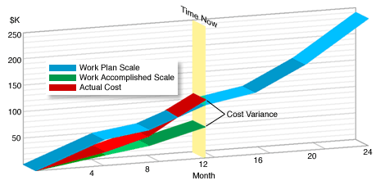
Example
The actual costs (AC) at this point in time is $110K.
The earned value (EV) is $60k.
The Cost Variance (CV) = EV – AC = 60 – 110 = -50.
[source: NASA]
SOEN384-L17: monitoring&control

Slide 39
Schedule Variance (SV)
Schedule Variance (SV): = EV – PV
  The difference between earned value and the planned budget.
  Or
  (what you should have paid for work actually accomplished) –
  (what you intend to pay for work accomplished)
  A positive number means you are ahead of schedule.
  A negative number means you are behind schedule.
SOEN384-L17: monitoring&control

Slide 40
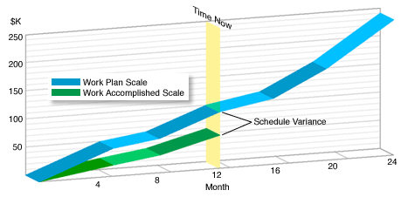
Example
The task was planned to have accomplished $100k worth of work in twelve months (PV), but the real accomplishment was only $60k (EV).
SV = EV – PV = 60 – 100 = -40.
The graph shows a "behind schedule" condition.
[source: NASA]
SOEN384-L17: monitoring&control

Slide 41
Cost Performance Index (CPI)
Cost Performance Index (CPI): EV / AC
  A ratio of the earned value over the actual cost of completed work,
  Or
  (what you should have paid for work performed)
  /
  (what was actually paid for work actually performed)
CPI value close to 1.0: Provides a strong indication that the project is within its defined budget.
CPI value < 1: Cost of completing the work is higher than planned.
CPI value > 1: Cost of completing the work is less than planned.
SOEN384-L17: monitoring&control
Notes:
CPI value close to 1.0: Provides a strong indication that the project is within its defined budget.
CPI value < 1: Cost of completing the work is higher than planned.
CPI value > 1: Cost of completing the work is less than planned.

Slide 42
Schedule Performance Index (SPI)
Schedule Performance Index (SPI): EV / PV
  Ratio of the earned value over the planned value.
It indicates the rate of progress: the efficiency with which the project is utilizing scheduled resources.
  An SPI value close to 1.0 indicates efficient execution of the project schedule.
  SPIs > 1 are favorable.
  SPIs < 1 are not favorable.
SOEN384-L17: monitoring&control
Notes:
An SPI value close to 1.0 indicates efficient execution of the project schedule.
SPIs > 1 are favorable.
SPIs < 1 are not favorable

Slide 43
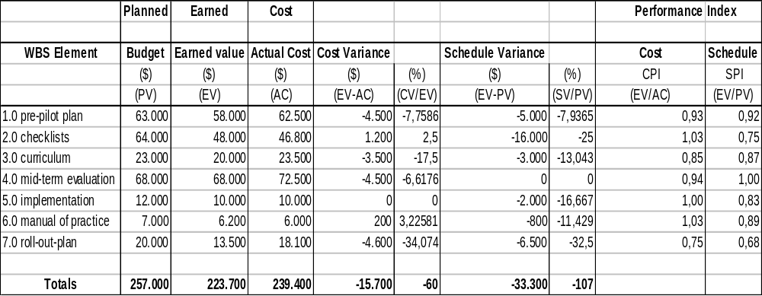
Example
[source: PMBOK, 2000]
SOEN384-L17: monitoring&control

Slide 44
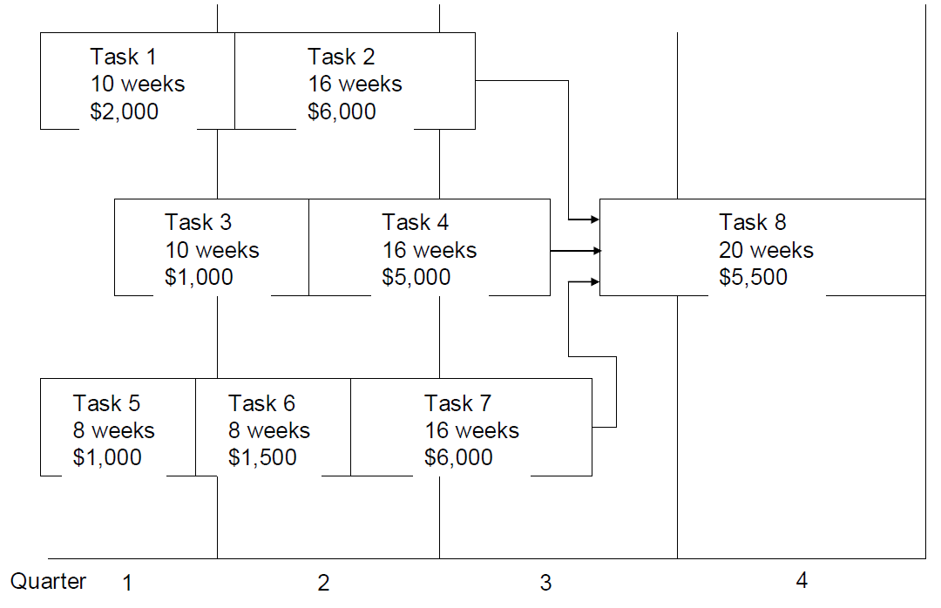
Example 1
(lecture notes of Dr Constantinides)
PLANNED:
Tasks 1, 3, 5, 6 must have been completed.
Task 2 should have been completed by 2/3,
Task 4 should have been completed by 40%,
Task 7 should have been completed by 50%.
PV?
REPORTED:
Tasks 1, 3, 5, 6 have been completed.
Task 2 have been completed by 2/3,
Task 4 have been completed by 40%,
Task 7 have been completed by 10%
EV?
AC = $10,000
SOEN384-L17: monitoring&control

Slide 45
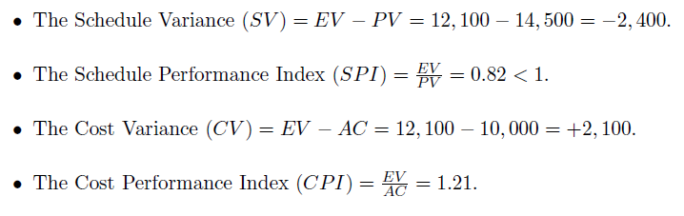
Example 1: performance indicators
(lecture notes of Dr Constantinides)
SOEN384-L17: monitoring&control

Slide 46




More Performance indicators (cont.)
The values for PV, AC and EV are used in combination to provide measures of whether or not work is being accomplished as planned.
  Budget at completion (BAC)
  Percent scheduled for completion
  Percent complete
  estimate at completion (EAC)
  Estimate to complete (ETC)
SOEN384-L17: monitoring&control

Slide 47




Example 1 cont.
BAC = $2,000+$6,000+$1,000+$5,000+$5,500+$1,000+$1,500+$6,000
= $28,000
Percent scheduled for completion = $14,500/$28,000
= 0.52 (52%)
Percent complete = $12,100/ $28,000
= 0.432 (43.2%)
  Estimate at completion (EAC)= $28,000/1.21
  =$23,140
  Estimate to complete (ETC) = $23,140-$10,000
  = $13,140
SOEN384-L17: monitoring&control

Slide 48
Key questions answered by earned-value analysis
We analyze past performance to control the future performance
PAST PRESENT FUTURE
Are we on schedule?
Are we on cost?
What are the significant variances?
What is the trend to date?
When will we finish?
What will it cost at the end?
How can we control the trend?
The Two Key Questions
1. Did we get what we wanted for what we spent?
2. At the end of the project, is it likely that the cost will be less than or equal to the original estimate?
SOEN384-L17: monitoring&control

Slide 49
Questions?
…
SOEN384-L17: monitoring&control

Slide 50
Next?
Tutorial in support of A2
ISO15939 financial performance measurement program
SOEN384-L17: monitoring&control

